Slide 1
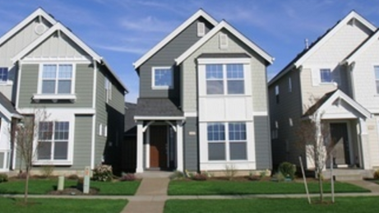
AMES, IOWA HOUSING PRICE PREDICTION

Slide 2
Problem Statement
How might I better estimate housing prices in Ames, Iowa so that I can manage potential buyers' expectations.
Stakeholder
I am a freelance data analyst building a housing price prediction model and my prime stakeholders are property agents/agencies who will use the model to manage their potential buyers' expectations.
Other potential stockholders include local banks and Ames Housing Authority.

Slide 3
Approach
My approach of this project is to study the historical housing prices in Ames and the housing dataset features provided by Ames, Iowa Assessor's Office. The processes involved data preparation, data massage, data visualization, data analysis and regularization.
Data Source
The housing data set provides historical housing prices from 1872 to 2010, and 80 other features related to the property, locations and sales processes.

Slide 4
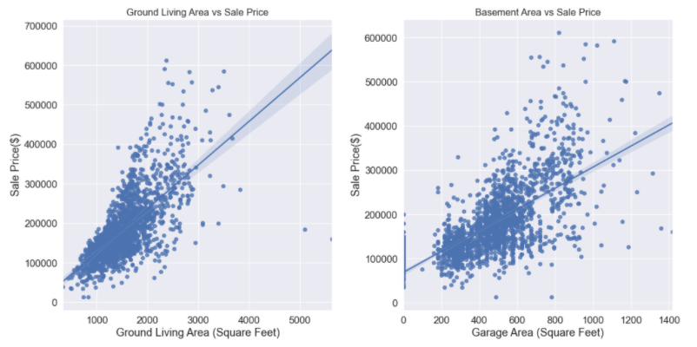
Identify the outliers
Outliers

Slide 5
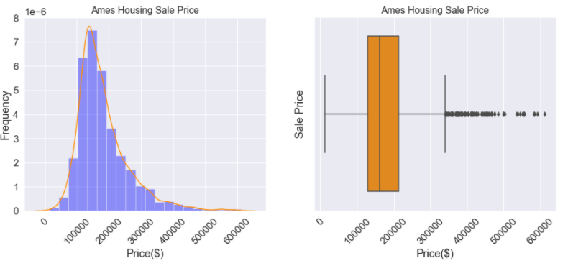
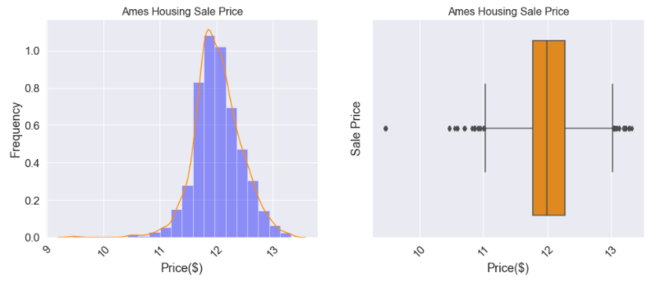
Sale Price Before Log-Transformed
Histogram shows that the `saleprice` is not normally distributed and right skewed.
Highly right skewed distribution will lead to the chances of producing errors may also be skewed negatively.
Sale Price After Log-Transformed
Histogram of the `saleprice` is now looked almost normally distributed

Slide 6
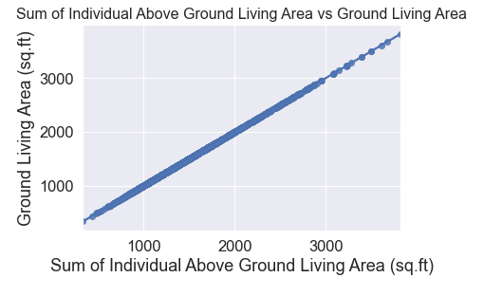
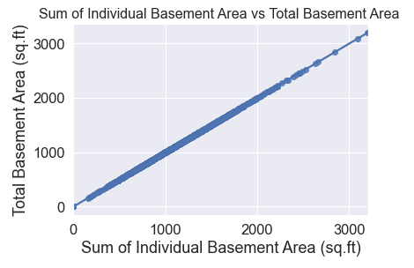
Multicollinearity example:
Scatter plot shows that `gr_liv_area` is highly positive correlation with the sum of sum of `1st_flr_sf`, `2nd_flr_sf` and `low_qual_fin_sf`.
To avoid the multicollinearity, I will use `gr_liv_area` for my prediction.
- Scatter plot shows that `total_bsmt_sf` is highly positive correlation with the sum of `bsmtfin_sf_1`, `bsmtfin_sf_2` and `bsmt_unf_sf`.
- To avoid the multicollinearity, I will use `gr_liv_area` for my prediction.

Slide 7
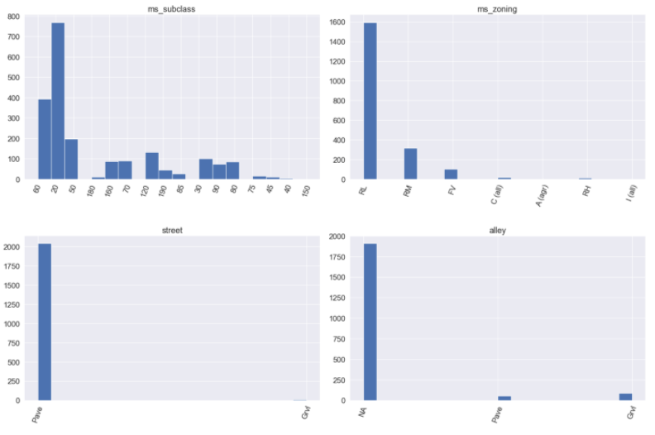
Over Presented Value example:
I notice that there are plenty of features have one value is heavily over presented.
If I apply this features into my prediction, the chances of the prediction of using the over presented data point will be higher as well, which will not good for my `saleprice` prediction.
I will not use the features with frequency of one value more than 70% for my price prediction.

Slide 8
Feature Engineering:
neighborhood
For the 'neighborhood' feature, I will categorise them into 4 groups based on the correlation between the individual neighborhood with the `saleprice`:
4 - neighborhood above 0.08 (Timber, CollgCr, Somerst, StoneBr, NridgHt, Veenker, NoRidge)
3 - neighborhood between 0 and 0.06 (SawyerW, Gilbert, Crawfor, NWAmes, ClearCr, Blmngtn, GrnHill, Greens)
2 - neighborhood between -0.1 and 0 (BrDale, Mitchel, SWISU, NPkVill, Blueste, Landmrk)
1 - neighborhood below -0.1 (Sawyer, NAmes, Edwards, OldTown, IDOTRR, MeadowV, BrkSide)
material
For the new `material` feature, I have applied the polynomial features method to combine the `exterior_1st`, `exterior_2nd`, `foundation` and `mas_vnr_type` features. All these features are related to the materials’ used for the construction. I have divided the sub-features into 1(negative colleration with the `saleprice`) and 2(positive colleration with the `saleprice`).
overall
For the new `overall` feature, I have applied the polynomial features method to combine the `overall_qual` and `overall_cond`. These 2 features are the overall rating of the house in term of materials used, finishing and condition of the house. The sub-features are based on the existing pointing system.

Slide 9
Feature Engineering:
quality
For the new `quality` feature, I have applied the polynomial features method to combine the `exter_qual`, `bsmt_qual`, `heating_qc`, `kitchen_qual`, `fireplace_qu`, `bsmtfin_type_1` and `bsmt_exposure` features. All these features are related to the quality rating of the house. The sub-features' pointing system are standardized range from 1(Poor) to 5(excellent).
overall age
For the new `overall_age` feature, I have applied the polynomial features method to combine the `house_age` and `remod_age` features. All these features are related to age of the house with/ or without remodeling.
house_garage
For the new `house_garage` feature, I have applied the polynomial features method to combine the `garage_type`, `garage_finish` and `house_style` features. All these features are related to the style and finishing for both house and garage.
All_bath
For the new `all_bath` feature, I have applied the polynomial features method to combine the `full_bath`, `bsmt_full_bath` and `half_bath` features. All these features are related to the number of full and half bath within a house.

Slide 10
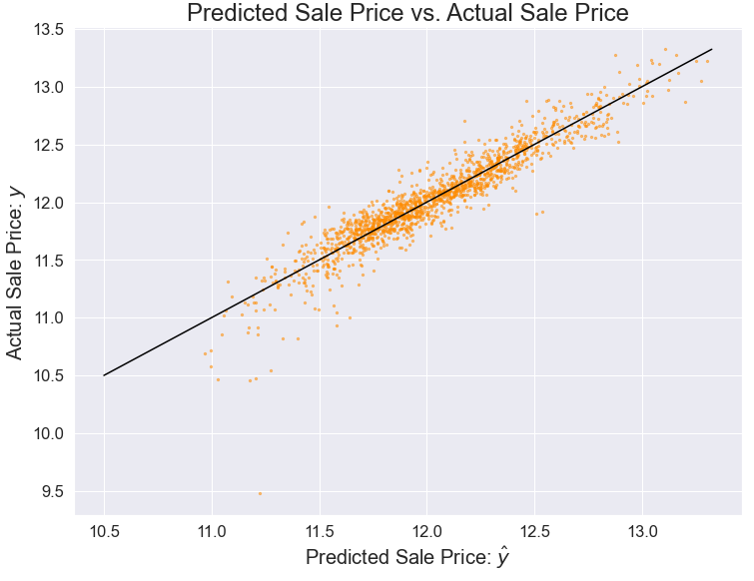
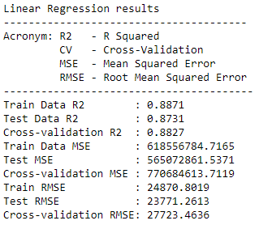
Result of Various Regression Methods Applied to Train-Test-Split Data
Linear Regression
Scatter plot shows that most of the points are fell on the diagonal line, it tells us that it would have a good fit.
Linear regression model performed quite well, with only 1.4% difference in R2 between train and test scores.

Slide 11
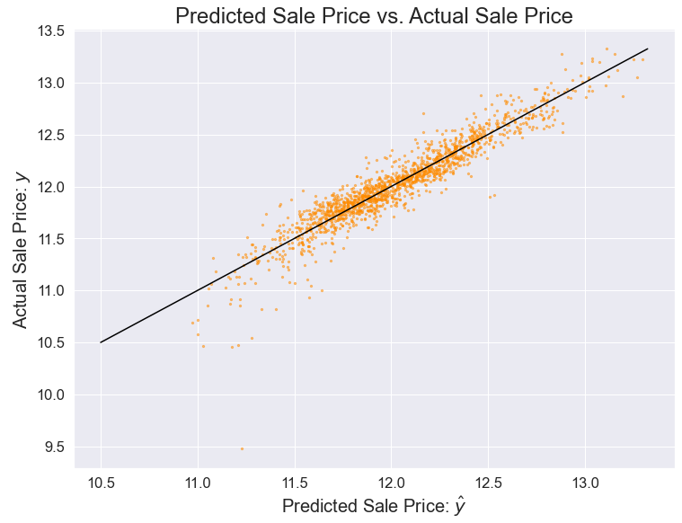
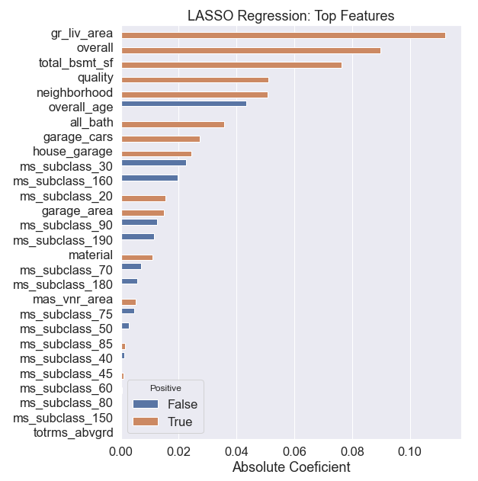
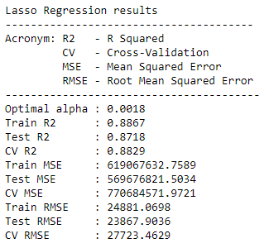
Lasso Regression
Scatter plot shows that most of the points are fell on the diagonal line, it tells us that it would have a good fit.
The top 3 positive coefficient that have biggest impact - `gr_liv_area`, `overall`, `total_bsmt_sf`.
The zero coefficient - `ms_subclass_80`, `ms_subclass_150` , `totrms_abvgrd`.
The top 3 negative coefficient that have worst impact -`overall_age`, `ms_subclass_30` , `ms_subclass_160`.
Lasso regression model performed quite well, with only 1.5% difference in R2 between train and test scores.

Slide 12
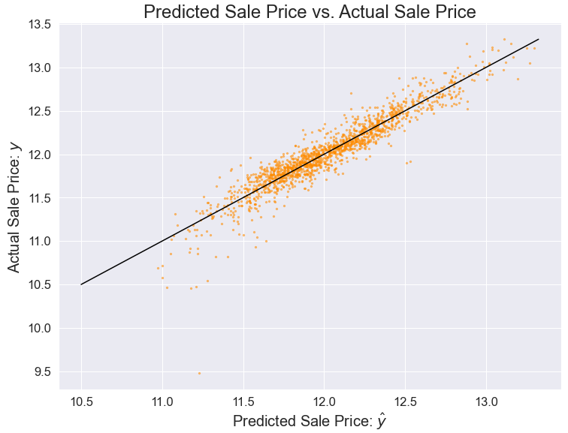
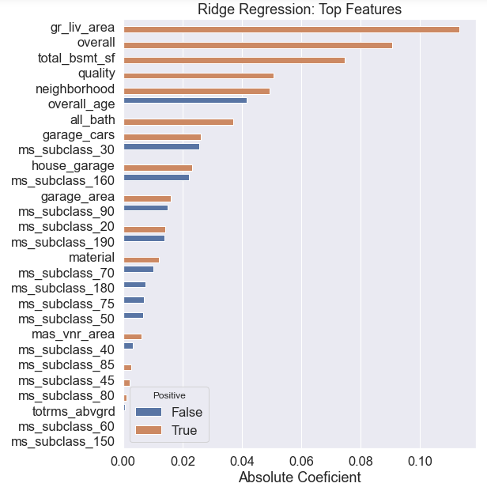
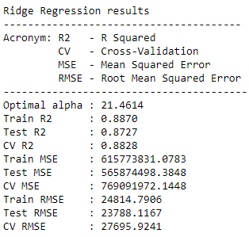
Ridge Regression
Scatter plot shows that most of the points are fell on the diagonal line, it tells us that it would have a good fit.
The top 3 positive coefficient that have biggest impact - `gr_liv_area`, `overall`, `total_bsmt_sf`.
The top 3 negative coefficient that have worst impact -`overall_age`, `ms_subclass_30` , `ms_subclass_160`.
Ridge regression model performed quite well, with only 1.4% difference in R2 between train and test scores.

Slide 13

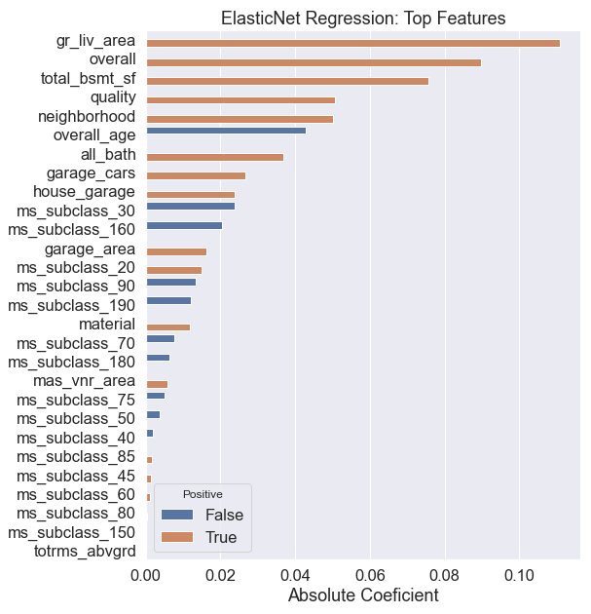
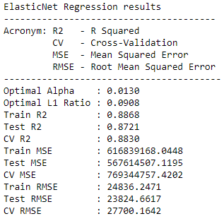
ElasticNet Regression
Scatter plot shows that most of the points are fell on the diagonal line, it tells us that it would have a good fit.
The top 3 positive coefficient that have biggest impact - `gr_liv_area`, `overall`, `total_bsmt_sf`.
The zero coefficient - `ms_subclass_150` , `totrms_abvgrd`.
The top 3 negative coefficient that have worst impact =-`overall_age`, `ms_subclass_30` , `ms_subclass_160`.
ElasticNet regression model performed quite well, with only 15.% difference in R2 between train and test scores.

Slide 14
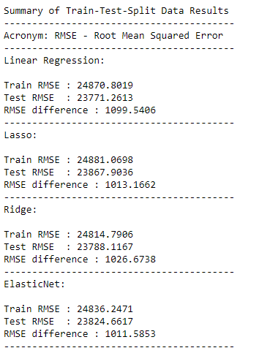
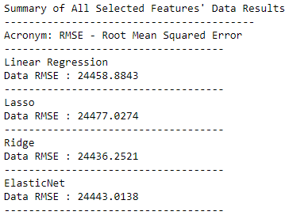
Summary of Train-Test-Split Data Results:
From the summarize table above, you can see that ElasticNet regression method has the less RMSE difference between train and test.
Summary of All Selected Data Results:
After I train all the selected features' data points of train dataframe, Ridge regression has generated the lowest root mean squared error (RMSE). So, Ridge regression is the suitable method to predict the test dataframe.

Slide 15
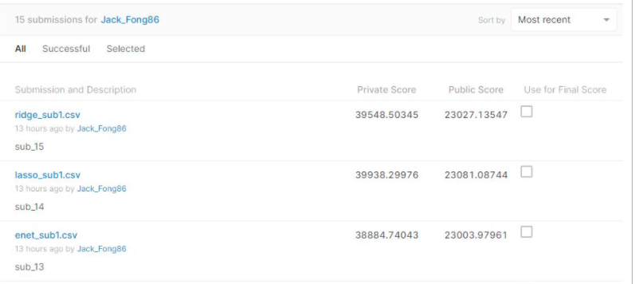
Kaggle Results

Slide 16
Conclusion:
From my analysis of the 80 features, I have created 28 new features (7 from the actual features, 6 new combined features and 15 dummy features). In the end, I have achieved the best results using the ElasticNet regression.
Of the top 5 features out of the 28 features in terms of price predictability based on the ElasticNet bar chart, 4 of them relate to the housing profile and only 1 (#4 neighborhood) relates to location.
1. above ground living area
2. overall (combination of overall quality and overall condition)
3. total basement area
4. neighborhood
5. quality (quality rating of various features)
However, the top 3 features that hurt the value most are:
1. overall age(age of the house with/ or without remodeling)
2. ms_subclass_30
3. ms_subclass_160
From my knowledge of housing prices and the property industry in general, it surprises me that location does not rate higher as the predictor. Moving forward, I should consider to include more location related features to improve my prediction. The aging of the house will obviously reduce the housing price.

Slide 17
Recommendations
- Value Impact Business Recommendations
The owner of the house can do a number of remodeling improvement to increase the value of the house but these would need to be cost justified. Example include expansion of the masonry veneer area, increasing size of garage, changing garage style or house style.
Based of the correlation between the neighborhoods and saleprice, the neighborhoods worth investing in are Timberland, College Creek, Somerset, Stone Brook, Northridge Heights, Veenker and Northridge.
The model is constructed based of the Ames, Iowa dataset. The basic predictability of the model is still applicable but it has to be customized based on the other cities features which involve changes.
- Data Massage
When running data massage routine, we must ensure our actions maintain data integrity, e.g. determining the percentage of allowable data to eliminate, imputation of the missing data or the consideration of the outlier(s). All these decisions will affect the prediction outcome.
- Feature Engineering Process
Feature engineering process requires lots of research, relevant domain knowledge and thorough EDA skills. A data analyst needs to acquire sufficient experience and domain knowledge to assist the efficient feature engineering process.
prediction model.

Slide 18
Recommendations
- Regression Model Selection
It is always good to apply various model to perform the regularization to get the better outcome. For my selected features, Ridge regression has computed lesser root mean squared error (RMSE) compare to the other regression model.
Overall
The housing prices are recorded from 1872 till 2010 whereby many other aspects are not considered such as world economy crisis, changes in state government housing policies, housing demand, land availability for development etc. All of these aspects will lead to fluctuations in housing prices.
From my perspective, we have to include all the factors capable of impacting housing prices. Doing so, we can have a better prediction of the housing price.
In addition, it is recommended that the model has to be revisited and updated with new information to ensure the model is improved.
Further research should be carried out on how to improve the feature engineering, further experiment with other models and start different polynomial features transform to improve the price prediction model.

